Slide 1
Polyglot Persistence and NOSQL
Julian Breyer
13 DEC 2017

Slide 2
Agenda INSERT INTO TABLE Round_HOLE VALUE “SQUARE_PEG”
Day 1:
----------------------------------------------------------------------
1. How did we get here?
2. Relational Database: PostgreSQL
3. Key-Value Store: RIAK
4. Document Store: MongoDB
Day 2:
----------------------------------------------------------------------
5. Row Store: Apache Cassandra
6. Column Store: Apache hbase
7. Graph Database: Neo4J
8. Putting It All Together

Slide 3
What this is and isn’t
Technical overview
Demos with a little theory and history
We have two hours so definitely not a deep dive
Not an ops guide
Not an endorsement of any particular technology

Slide 4
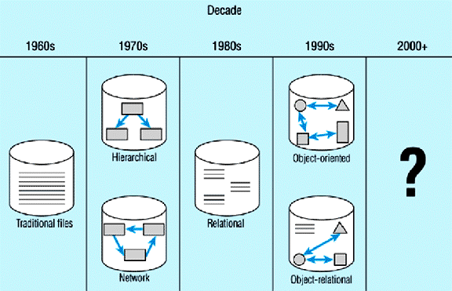
how did we get here?

Slide 5
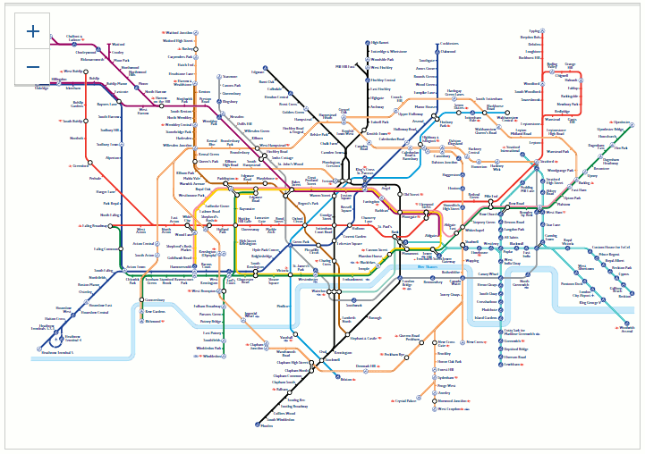
how did we get here?

Slide 6
So… what’s wrong with SQL?
Nothing!
+ RDBMS are a proven, extremely powerful technology
+ SQL is (relatively) easy to learn
+ Schema enforcement helps with data quality
- Doesn’t easily scale to Internet scale (IoT, sensors, telemetry, …)
- Partitioning is possible but tedious
- Data comes in many shapes (structured, semi-structured, unstructured) – relations are not a good representation of all of them but the same is true for all of the other technologies.

Slide 7
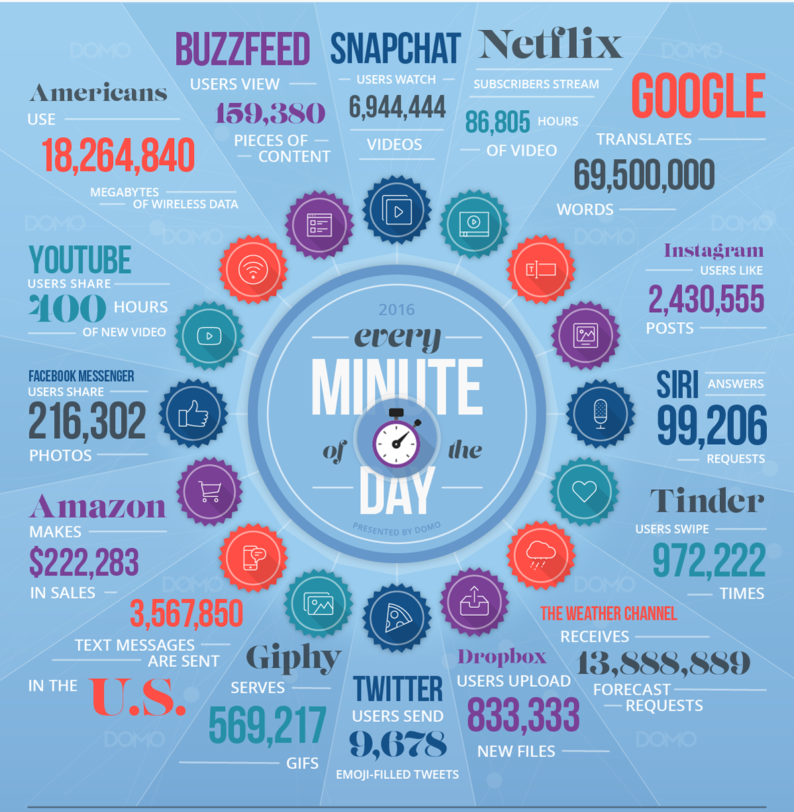

Slide 8
Relational Databases
The grandfather of data persistence

Slide 9
Relational Databases
Based on relational calculus (“A Relational Model of Data for Large Shared Data Banks” E.F. Codd, IBM, 1970).
Uses the Structured Query Language (SQL) introduced by Boyce and Chamberlain (IBM, 1972).
Expresses what should be retrieved rather than how to retrieve it
Organization in relations (represented as tables) consisting of columns and rows (tuples).
Each row is identified by a key.
The structure of the table is dictated by a schema that all data must adhere to.

Slide 10
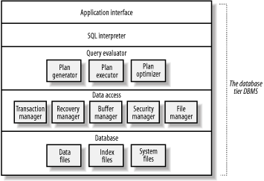
Components of an RDBMS

Slide 11
ACID
ACID – term coined by Jim Gray:
Atomicity
“All or nothing” – either all parts of a transaction are completed or none are.
Consistency
Changes to one part of the database must not lead to the inconsistency of another part (enforced through constraints)
Isolation
Concurrent reads/writes are serialized so as to not intermix
Durability
Once a transaction is committed, its effects must persist

Slide 12
SQL 101
Declarative vs Imperative (i.e. what vs how)
Three different types of statements:
Data Definition Language (DDL)
CREATE, DROP, ALTER
Data Manipulation Language (DML)
SELECT, INSERT, UPDATE, DELETE
Data Control Language (DCL)
GRANT, REVOKE, …

Slide 13
Example: Customer DB

Slide 14
What Are RDBMS good for?
Homogenous data adheres to a rigid schema
Allows for flexible queries
Very consistent and durable
ACID transactions

Slide 15
What Are RDBMS not good at?
Scaling! (usually only up, not out)
Flexible/unstructured data
Impedance mismatch (i.e. the complexities of translating object-oriented application data structures into the relational model through ORM)

Slide 16
Common Examples
Microsoft SQL Server
Oracle RDBMS
Postgres
MySQL

Slide 17
Key-Value Stores
The simplest data store you can find

Slide 18
KV Stores
Pretty much a hash-table persisted on disk
The data store does not care about the structure of the value and data is typically not queryable by anything in the value (only by the key)
Key
Value

Slide 19
Example: RIAK
RIAK doesn’t even implement a query language – just http endpoints
Creates buckets automatically
Add keys with PUT
Delete keys with DELETE
Resolve queries with GET

Slide 20
Demo - RIAK

Slide 21
When KV Stores are great
If you always know and query by the key
For quick, discrete lookups

Slide 22
Examples
RIAK
REDIS
(MEMCACHED)
Azure Table Storage

Slide 23
A better inventory and order system: Document stores

Slide 24
Properties of Document Stores
Typically schema free
Records in the same collection do not have to have the same structure
Columns can have multiple values (arrays) or have nested structures
Special case of the KV-store we just looked at
Part of the NoSQL family
Built for simplicity
Flexible query options
Documents are typically JSON but can be plain text value in a KV store (would require external de-serialization)

Slide 25
Example: MongoDB
SELECT = db.[collection].find()
INSERT = db.[collection].insertOne() / db.[collection].insertMany()
UPDATE = db.[collection].updateOne(<filter>, <update>, <options>) / db.[collection].updateMany() / db.[collection].replaceOne()
DELETE = db.[collection].deleteOne() / db.[collection].deleteMany()
OMG – the mongo shell is also a full JS interpreter!

Slide 26
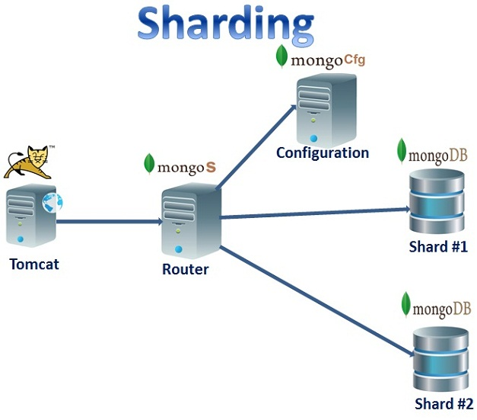
MongoDB Architecture

Slide 27
Demo TIME

Slide 28
WHY IS THIS A THING?
Easy to learn / get started
Development first approach
Since there’s no schema, document structure can change any time
Richer queries than in a KV store
Documents are represented as objects so low impedance (no ORM necessary)

Slide 29
What are Document Stores good at?
User profile and behavior data
Storage of application metadata / object persistence
Ingestion and presentation of data of variable structure (e.g. logs, product catalogs…)

Slide 30
What are DOCUMENT Stores not good at?
OLAP
Complex Map/Reduce jobs
Distributed transactions
Highly relational data

Slide 31
Typical Examples
MongoDB
Amazon DynamoDB
Couchbase
CouchDB

Slide 32
Intermission: Brewer’s CAP Theorem

Slide 33
Brewer’s CAP Theorem
Brewer’s CAP Theorem states that there are three possible properties of data stores, only two of which any given data store can have:
Consistency (every read receives the most recently written data or an error)
Availability (Every query yields an answer but without any guarantee that it’s the most recent write)
Partition Tolerance (The overall system continues to work even when messages between instances are dropped or delayed)

Slide 34
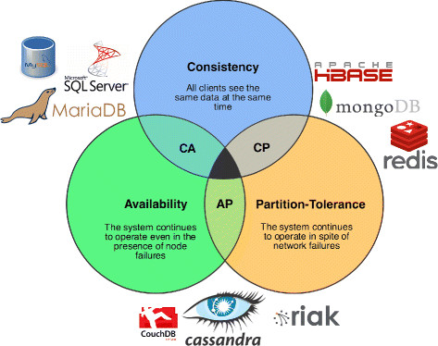

Slide 35
Brewer’s CAP Theorem
Most NoSQL data stores can’t guarantee ACID properties so BASE was developed as a basic set of guarantees:
Basically Available
Soft state
Eventually consistent (if an object has not changed, all instances will eventually yield the same answer to a query)

Slide 36
A DISTRIBUTED, partitioned row-store: Apache Cassandra
A distributed RDBMS without JOINs? Whoa!

Slide 37
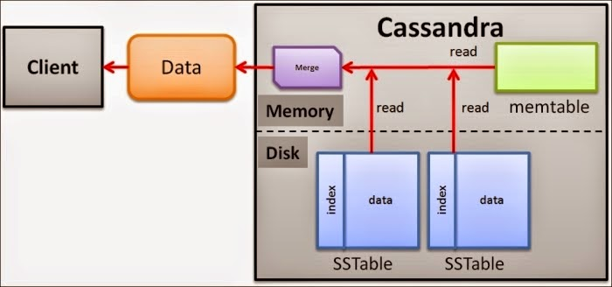
Cassandra Architecture

Slide 38
Apache Cassandra
Originally based on Google’s Big Table paper (like hbase and Accumulo).
Originally used Apache Thrift for flexible schema (now deprecated).
Now uses SQL-like Cassandra Query Language (CQL) and mandatory schema enforcement.
Behaves a lot like an RDBMS but adds clustering keys to make resolution of data to a node more efficient.
Unlike other Big Table based databases, stores rows together (like and RDBMS) rather than columns or column families (like a column store).

Slide 39
Cassandra Demo

Slide 40
What would you use Cassandra for?
Large number of writes
Pre-determined analytics queries
Large scale geographic distribution

Slide 41
Column Store: Apache Hbase

Slide 42
Hbase’s Table structure
Row Key | Column Family 1 |  | Column Family
 | Column Qualifier 1 | Column Qualifier 2 | Column Qualifier 1 | Column Qualifier 2
… | ... | … | … | …
… | … | … | … | …

Slide 43
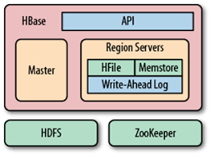
Hbase architecture

Slide 44
What makes Column stores special?
Storage by column makes analytical processing of particular attributes faster.
Requires de-normalized data storage
Lends itself to wide tables with lots of columns
No concept of transactions
Great for OLAP, not so much for OLTP
Schemaless
Within a column family, columns can be defined on-the-fly and only columns that are present for a row are stored (leading to sparse tables).
Emphasis on API access rather than a high-level query language.
Linear scalability: just add more nodes

Slide 45
Graph DB: Neo4J

Slide 46
Graph DBs are all about relationships
Basic ingredients: Nodes, relationships and properties.
Movie: Johnny Mnemonic
Starred in
Person: Jim
Movie: Matrix
Actor: Keanu
reviewed
Starred in
Friends with
Starred in
Actor: Carrie

Slide 47
What are Graph DBs great for?
Complex connections between different entities
No joins necessary!
Graph/model can be evolved over time w/o having to change historical data.
Allows for context-richness
Example applications: recommender engines, n-degrees of separation queries

Slide 48
What not to use them for?
OLAP
Highly relational data.
[in Neo’s case] massive data sets

Slide 49
Polyglot persistence
Putting it all together

Slide 50
So… which of these should I pick?
Many considerations:
Volume
Structure (or lack thereof)
Durability
Geographic distribution
Reporting needs
Scaling needs (up/out)
…

Slide 51
Challenges
Skillset
3rd party / community support
HA/DR
Integrity / schema enforcement

Slide 52
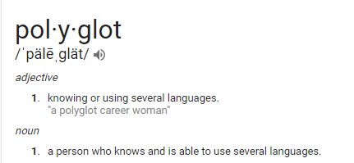
What is polyglot persistence

Slide 53
What is Polyglot Persistence?
Why limit yourself to one choice (kind of like using a hammer as the only construction tool)?
Storage is cheap, bad data models are not.
Use whatever combination of data stores best meets your data needs even if that means you have to store data multiple times.

Slide 54
Example: A shopping website
E-Commerce Platform
Cart
Orders
Catalog/
Reviews
Suggestions
ClickStream
Key/Value
RDBMS
Document
Graph
Column

Slide 55
One more thing
SQL developers are readily available, developers for any of these data stores are much more scarce.
SQL has been around for decades, these stores come and go.
Databases like Postgres have been augmented with features that can often bridge the gap if an RDBMS is a decent but imperfect match.

Slide 56
Questions?

Slide 57
kthxbai
Examples available at github.com/jbreyer
Feel free to ask questions: julian.breyer.civ@mail.mil

